Slide 1

Evaluating the Costs & Benefits of AI
Module 9 — A practical framework for making smart AI adoption decisions

Slide 2

Our Goal: Smart AI Decision-Making
This module equips you to analyze AI adoption decisions through a comprehensive lens—weighing financial, operational, ethical, and social costs against tangible benefits.
Practical evaluation skills
Learn to assess AI adoption in personal, team, and organizational contexts with real-world frameworks.
Cost justification mastery
Determine whether AI delivers sufficient value relative to all costs—both visible and hidden.
Responsible adoption mindset
Balance innovation with ethics, privacy protection, and essential human oversight.

Slide 3

AI as a Strategic Tool
AI isn't a guaranteed solution—it's a strategic investment that requires careful evaluation. Success depends on understanding both quantitative metrics and qualitative impacts.
The dual nature of cost justification
Quantitative: Financial savings, time efficiency, measurable productivity gains
Qualitative: Ethical considerations, social responsibility, team morale, reputation
Effective evaluation demands examining direct and indirect costs alongside tangible and intangible benefits.

Slide 4






Understanding AI Costs
Financial Costs
Human Resources Costs
Software subscriptions, licenses, cloud services, and hardware investments add up quickly.
Training programs, workflow adaptation, change management, and ongoing monitoring require dedicated time.
Example: $50/month × 12 months × 10 users = $6,000/year
Example: 10 hours × $50/hour = $500 per employee
Opportunity Costs
Social & Ethical Costs
Time and resources diverted from other productive tasks or strategic initiatives.
Risks of algorithmic bias, privacy violations, workforce disruption, and potential reputational or compliance costs.
What hidden costs might your team face? Consider technical debt, integration challenges, and resistance to change.

Slide 5





Understanding AI Benefits
Productivity Gains
Dramatically faster execution of repetitive or complex tasks frees teams for high-value work.
Example: 5 hrs/week saved × $50/hr × 10 employees × 50 weeks = $125,000/year
Decision Support
Data-driven insights enable smarter business decisions with greater confidence and accuracy.
Creativity & Innovation
AI-assisted brainstorming, rapid prototyping, and enhanced content creation unlock new possibilities.
Competitive Advantage
Faster delivery, improved quality, and superior customer experience differentiate your organization.
Remember: benefits often require effective human-AI collaboration. AI amplifies human capabilities rather than replacing them.

Slide 6
Cost-Benefit Analysis Framework
01
02
Select a specific AI tool or scenario
List all costs comprehensively
Focus on a concrete use case rather than abstract possibilities.
Include financial, human resources, opportunity, and ethical/social costs.
03
04
Identify all benefits thoroughly
Quantify wherever possible
Capture quantitative gains and qualitative improvements across stakeholders.
Translate impacts into measurable metrics and dollar values when feasible.
05
06
Calculate Net Benefit
Determine cost-justifiability
Apply the formula: Net Benefit = Total Benefits − Total Costs
Make an informed decision based on comprehensive analysis and context.
At what point does AI provide sufficient ROI for your specific situation?

Slide 7
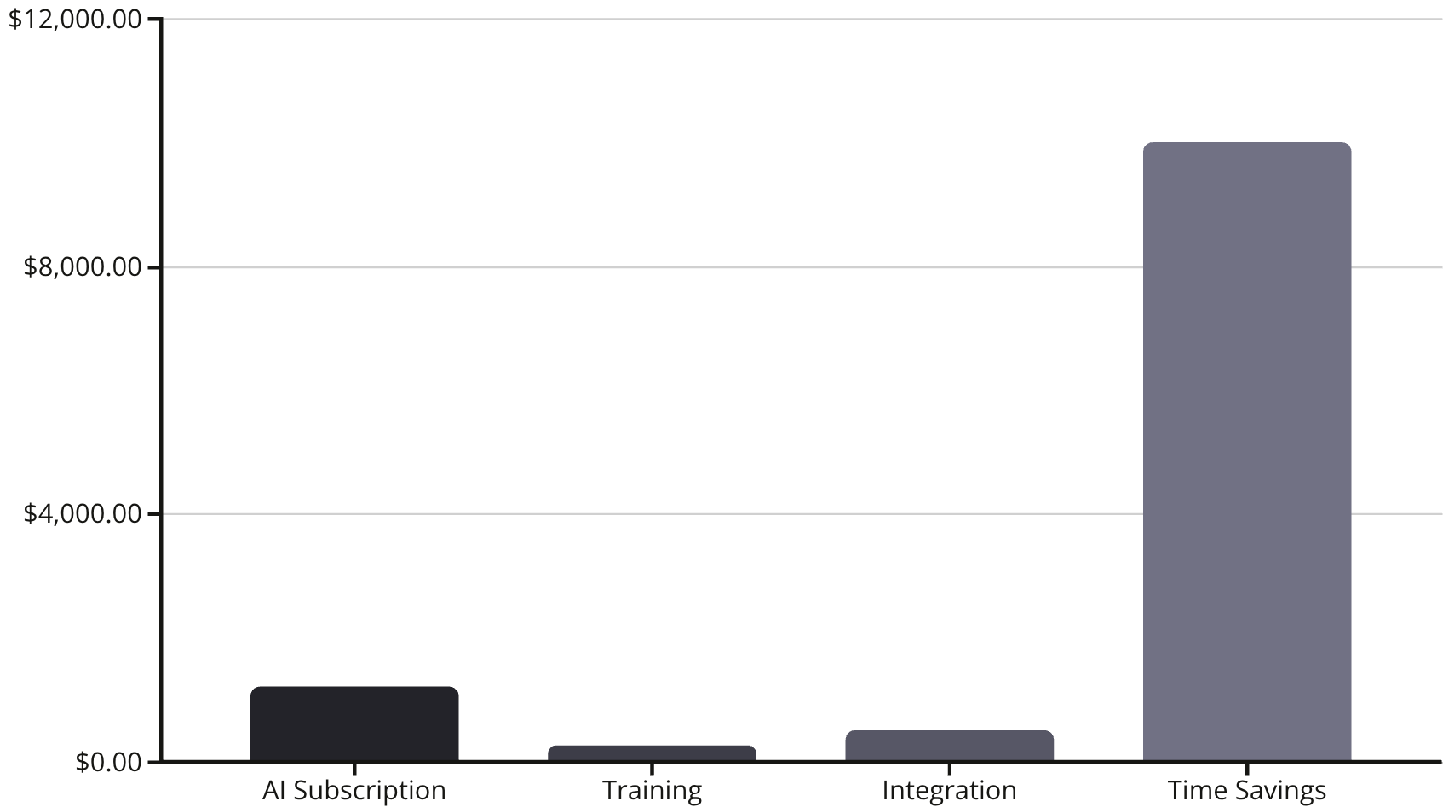
Example: Automating Marketing Reports
Scenario Analysis
Cost Breakdown
A marketing team evaluates automating their weekly reporting process. Let's examine the complete cost-benefit picture.
AI tool subscription: $1,200
Employee training: $250
Integration time: $500
Total Costs: $1,950
Benefit Breakdown
Time saved: $10,000 (4 hrs/week × $50 × 50 weeks)
Improved accuracy & insights: Qualitative
Total Quantitative Benefits: $10,000
Net Benefit: $8,050
Decision: Cost-Justifiable ✅
Even before considering qualitative benefits, the quantified savings significantly outweigh adoption costs.

Slide 8





Hands-On Analysis Activity
Now it's your turn to apply the cost-benefit framework to a real scenario. This 30-40 minute exercise will sharpen your evaluation skills.
Select Scenario
10 minutes
Choose a personal, professional, or community AI use case that matters to you.
Identify Costs & Benefits
15-20 minutes
Use the analysis matrix to capture quantitative and qualitative factors across all stakeholder groups.
Calculate Net Benefit
5-10 minutes
Determine adoption viability and document your decision rationale.
Remember to consider multiple stakeholders (team members, organization, customers) and weigh ethical, privacy, and social considerations—even when financial justification seems clear.

Slide 9

Reflection & Discussion
Take time to reflect on your analysis and engage in meaningful dialogue with peers. Cost-benefit evaluation is both art and science.
Surprising Discoveries
Which costs were most surprising or commonly underestimated in your analysis?
Justification Assessment
Did the benefits justify adoption? What factors tipped the balance one way or another?
Ethical Considerations
How did ethics, privacy concerns, or human oversight requirements influence your final decision?
Sensitivity Analysis
How would changing key assumptions (subscription cost, time saved, hourly rates) alter your cost justification?
Remember: cost-benefit analysis is iterative and context-sensitive. As conditions change, revisit your evaluation to ensure continued alignment with organizational goals.

Slide 10

Optional Showcase
Share Your Analysis
Present your AI cost-benefit analysis in 3-5 minutes, focusing on decision rationale, key assumptions, and lessons learned.
Peer Discussion Questions
Would you adopt AI in this scenario? Why or why not?
Which assumptions were most critical to your conclusion?
What would need to change to flip your decision?
How might this analysis differ in 6 months or a year?
Learning from diverse perspectives strengthens everyone's evaluation capabilities and reveals blind spots in our own analysis.

